Slide 1
Year 3 Class information 2022-2023 Lent Term 1
St Patrick’s Catholic Primary School.

Slide 2
Year 3 Lent Term 1 2022-2023
Welcome back!
We hope you have all enjoyed a restful, well-deserved Christmas break with friends and family.
Staff working in Y3
Miss Whelan, Mrs Hoskins
What to bring to school -
2 water bottles
Healthy snack- no chocolate bars or sweets
Outdoor shoes
PE Day
Your child should wear their PE kit on a Wednesday and Friday.
No earrings should be worn on PE days and trainers/plimsolls should be worn
English | Maths | RE
The Iron Man – Ted Hughes Fronted adverbials Direct/indirect speech | Multiplication and division | Journeys
Science | Topic | PE
Rocks, soils and fossils | History – The Bronze and Iron Age | Dance
English
This half term, we will be reading the Iron Man. This is a narrative which links with our history topic, the Bronze and Iron Age. We will explore writing a newspaper report about the Iron Man on the loose, as well as a narrative.
Maths
This half term we will begin with the second multiplication and division unit. We will explore in greater depth relationships between the two operations and develop our reasoning skills. We will then move on to learning about length and perimeter.

Slide 3
Year Lent Term 1 2022-2023
English Vocab
Maths Vocab
RE topic words
Science key words
Topic key words
Adverb | Fronted Adverbial | Proper noun | Common noun
Time | Place | Cause | Direct Speech
Question mark | Noun | Verb | Inverted comma
Multiply | Divide | Lots of/groups of | Greater
Smaller | Equal | Length | Perimeter
Cm, mm, m | Compare | Calculate | Equivalent
Ordinary time | Community | Celebration | Blessing
Sacrament | Calendar | Seasons | Feast day
Rock | Soil | Fossil | Metamorphic
Igneous | Sedimentary | Pressure | Organic Matter
Bronze | Iron | Period | Evidence
Reconstruction | Farming | Development | Impressive
Smelting | Ore | Hoard | Beliefs

Slide 4
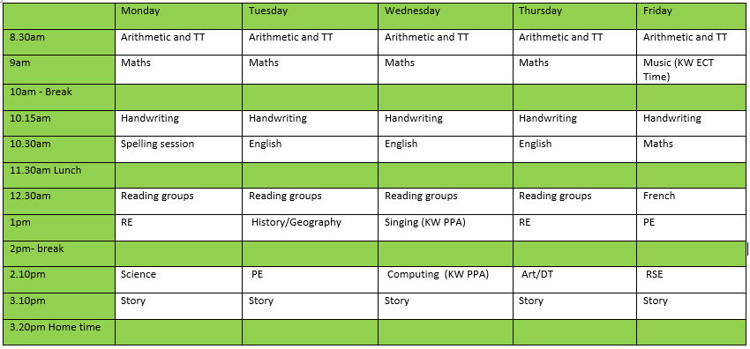
Year 3 Lent Term 1 2022-2023
Class Timetable
Keeping in touch:
As parents, you are the first educators of your child and at this school we recognise that the partnership between home and school is fundamental to a child’s success. School staff are always happy to speak to parents during the week before or after school, please contact the below email address or the office for an appointment.
Please email the class email address if you need to pass on any information or have any concerns.
The email address is Year3@st-patricksrc.notts.sch.uk
We will also keep you informed when we have additional adults working in a class or when there are changes to the staff members.

