Slide 1
Teacher- Miss Whelan Teaching Assistant- Mrs Hoskins
Meet the Teacher
Year 3
Belonging, caring, sharing safe in the arms of
God’s love

Slide 2
Who is who in school…
https://www.st-patricksrc.notts.sch.uk/our-academy/our-staff/

Slide 3
Communication
Year 3 communication will be via the following:
Parentmail
Class email address-
Year3@st-patricksrc.notts.sch.uk
School Website-
https://www.st-patricksrc.notts.sch.uk /
Belonging, caring, sharing safe in the arms of
God’s love

Slide 4
Attendance and Punctuality
Our school day timings are 8.30am - 3.20pm
The gates to school will be open until 8.45am, after this you need to report to the main office via the Ling Forest
Road entrance, after 8.45am your child will be registered as late.
Belonging, caring, sharing safe in the arms of
God’s love

Slide 5
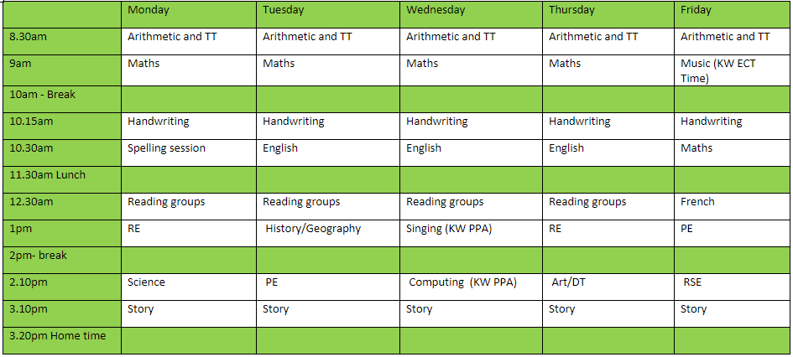
Class Timetable
Belonging, caring, sharing safe in the arms of
God’s love

Slide 6
Topics covered in Year 3
History Geography
The Stone Age Our world
The Bronze and Iron Age Water, weather and climate
Local History – Mining Coastal areas
Science
Animals including humans
Plants
Rocks
Forces and magnets
Light
Belonging, caring, sharing safe in the arms of
God’s love

Slide 7
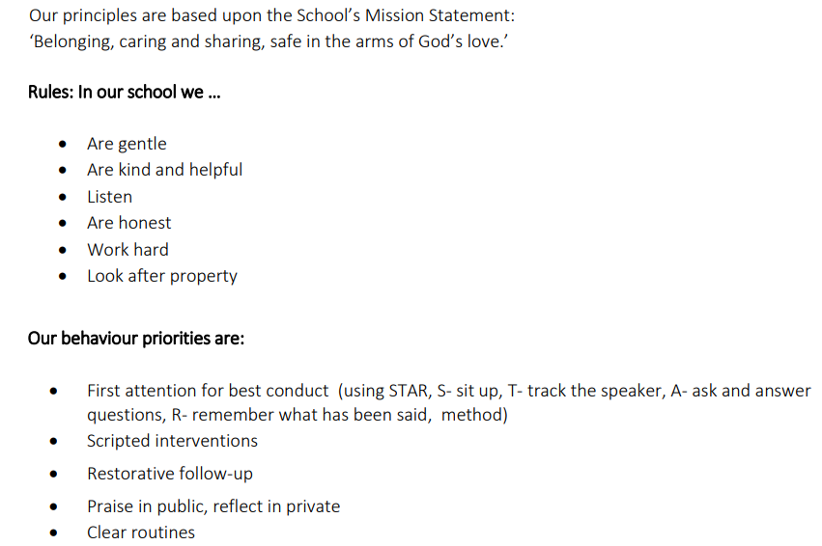
Behaviour expectations and rewards
Belonging, caring, sharing safe in the arms of
God’s love

Slide 8
Reading books- accelerated reader and STAR assessments Y2-6
Accelerated reader is a computer program that helps teachers and librarians manage and monitor children’s independent reading practice. Your child picks a book at his own level and reads it at his own pace. When finished, your child takes a short quiz on the computer. (Passing the quiz is an indication that your child understood what was read.) Accelerated Reader gives children, teachers, and librarians feedback based on the quiz results, which the teacher then uses to help your child set goals and direct ongoing reading practice.
Children using Accelerated Reader choose their own books to read, rather than having one assigned to them. This makes reading a much more enjoyable experience as they can choose books that are interesting to them.
Teachers and librarians help your child choose books at an appropriate readability level that are challenging without being frustrating, ensuring that your child can pass the quiz and experience success.
If your child does not do well on the quiz, the teacher or librarian may help your child:
Choose another book that is more appropriate.
Ask more probing questions as your child reads and before your child takes a quiz.
Pair your child with another student, or even have the book read to your child.
In most cases, children really enjoy taking the quizzes. Since they’re reading books at their reading and interest levels, they are likely to be successful. This is satisfying for most children. Best of all, they learn and grow at their own pace.
Belonging, caring, sharing safe in the arms of
God’s love

Slide 9
Reading books- accelerated reader and STAR assessments Y2-6
Star Reading is a computerized reading assessment that uses computer-adaptive technology. Questions continually adjust to your child’s responses. If the child’s response is correct, the difficulty level is increased. If the child misses a question, the difficulty level is reduced. The test uses multiple-choice questions and takes approximately 15 minutes
Once your child has completed their STAR assessment this will be sent home so are aware of their progress. On this document will be their ZPD score and reading age.
Belonging, caring, sharing safe in the arms of
God’s love

Slide 10
STAR Maths assessment Y2-6
Star Assessments are short tests that provide teachers with learning data. Star tests are computer adaptive, which means they adjust to each answer your child provides. This helps teachers get the best data to help your child in the shortest amount of testing time (about one-third of the time other tests take).
Your child may take a Star test for early literacy, math, reading, or other subjects of their teacher’s choice
Belonging, caring, sharing safe in the arms of
God’s love

Slide 11
No specific assessment in Year 3. Throughout the year we will use both formative and summative assessment to measure progress, for example:
STAR assessment
Pre and post learning
Quizzes – times tables, spelling
Belonging, caring, sharing safe in the arms of
God’s love

Slide 12
Support at home
We thank you for your support at home right from the beginning of this term.
We will continue to keep you updated and informed of any changes in class.
Homework is set on Friday and due in the following week. We will look through homework and ensure that if there is anything children are unsure of or struggle with, that we pick up on this and spend time going over it.
Belonging, caring, sharing safe in the arms of
God’s love

Slide 13
Any questions
Belonging, caring, sharing safe in the arms of
God’s love

