Slide 1
Reading and Phonics in
Reception

Slide 2
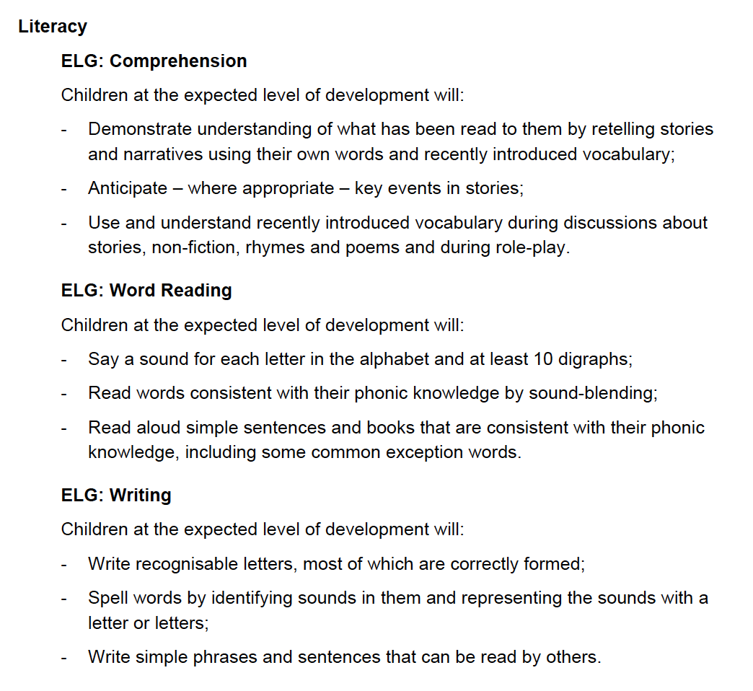
Early learning goals
In the Early learning goals document on our website all the areas of learning are shared. These are the literacy goals of the statutory framework from the Department of Education.
We assess using this framework at the end of May.

Slide 3
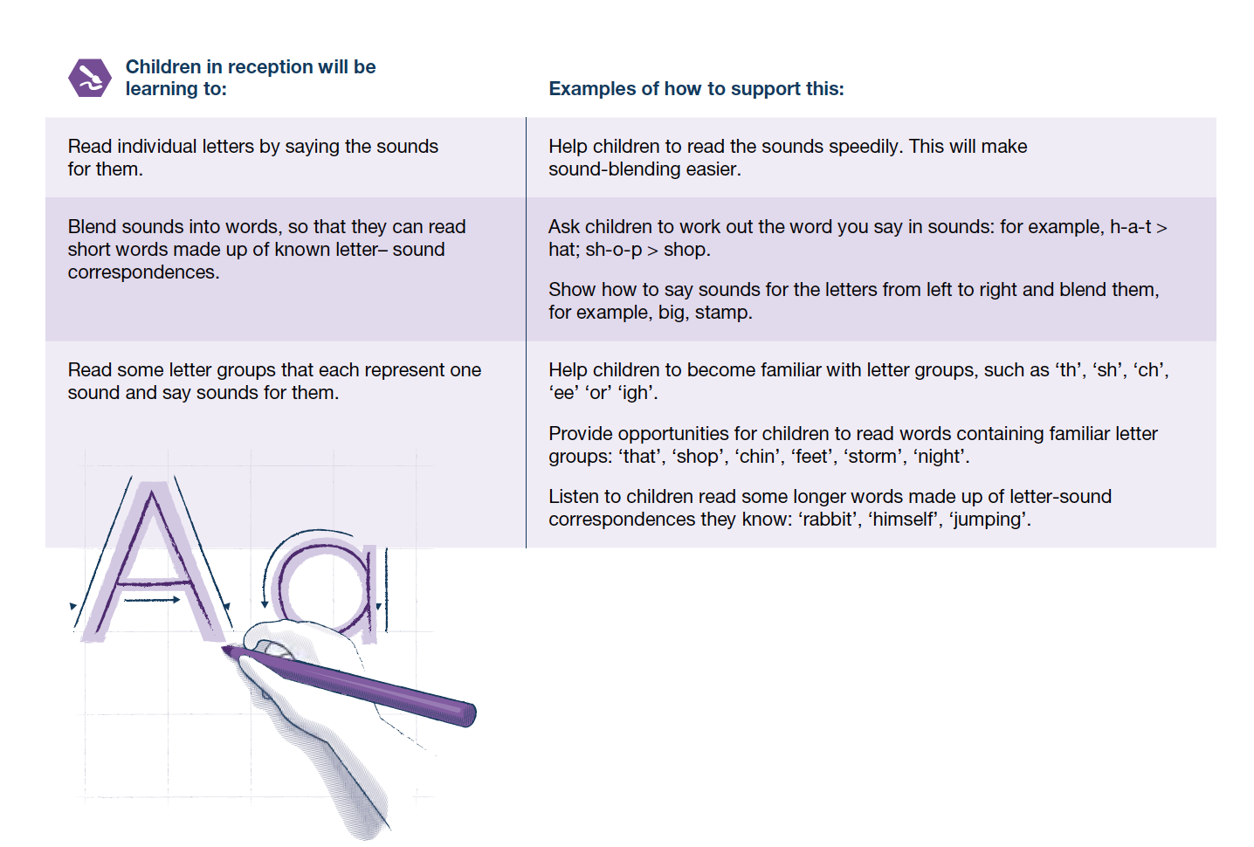
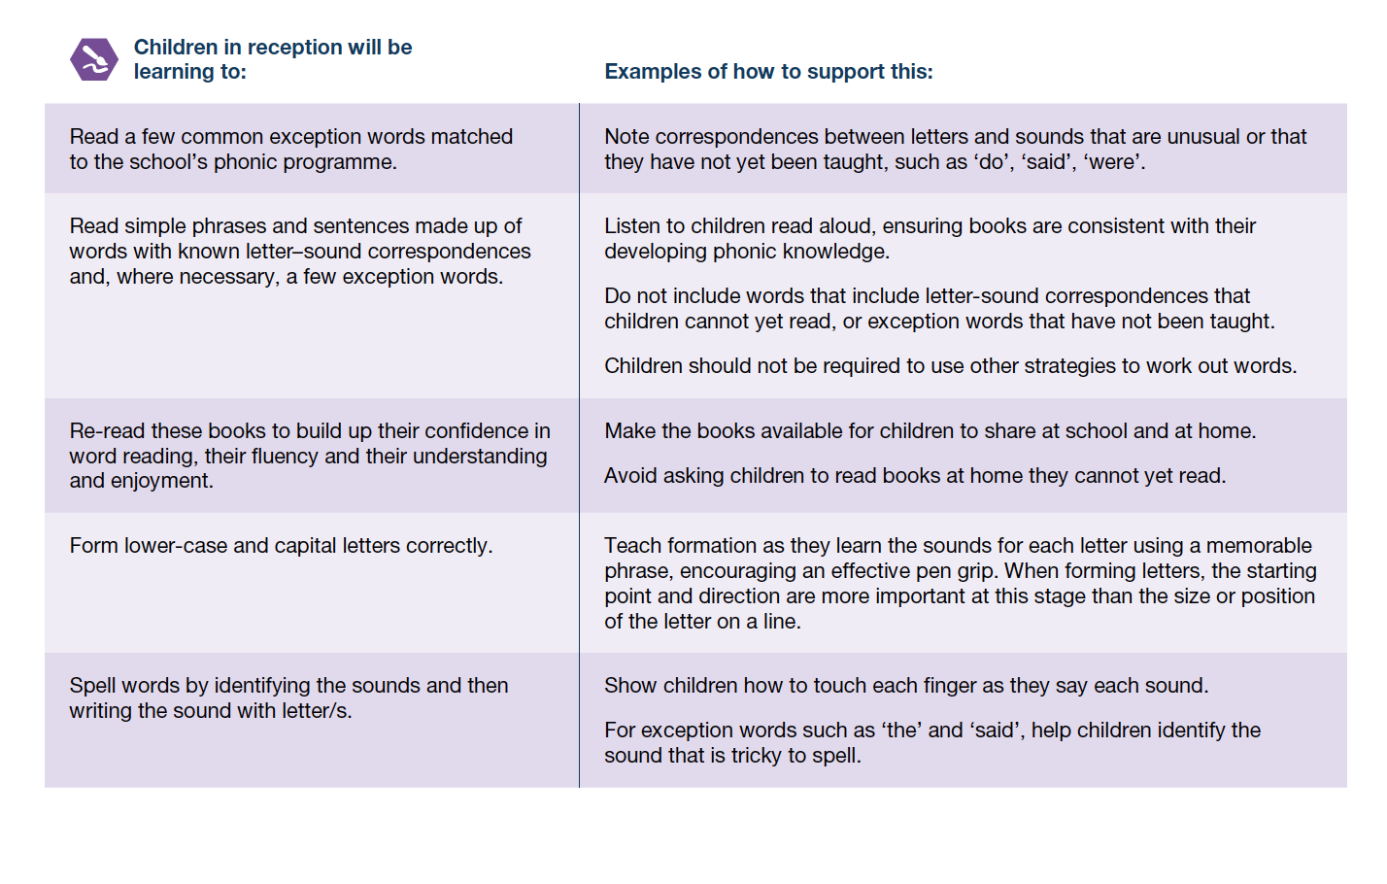
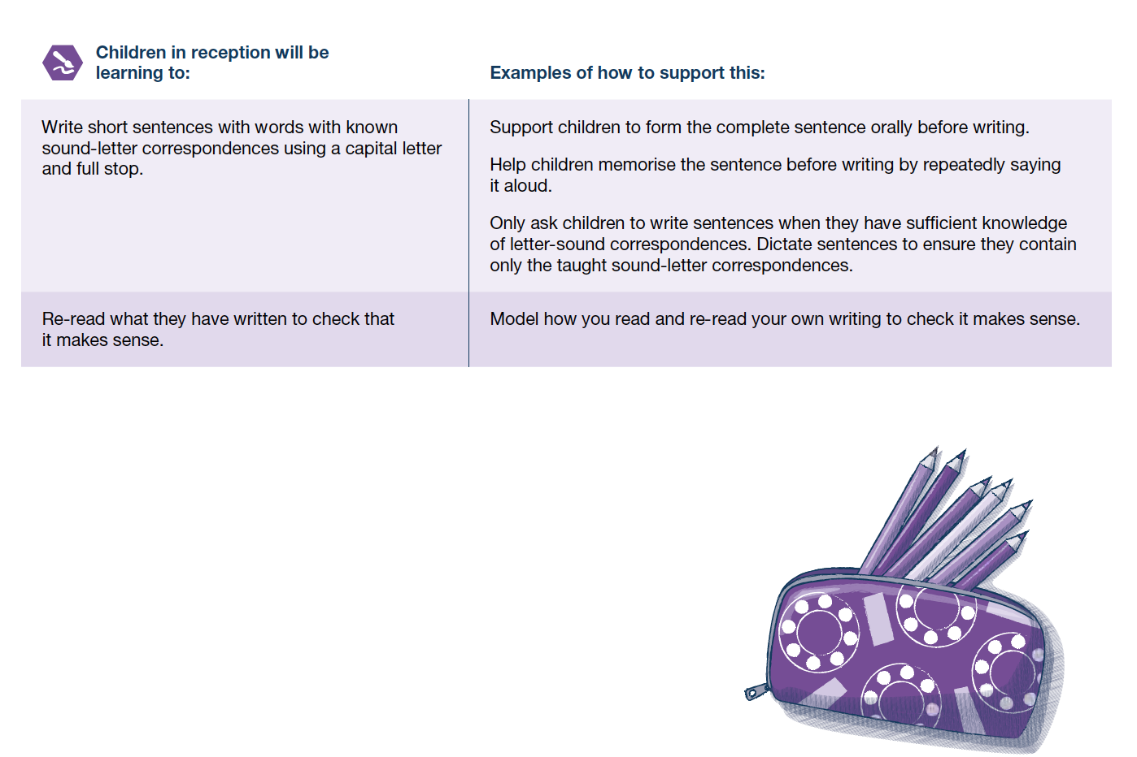
Development matters
This shows in a little more detail what we are learning to do.

Slide 4
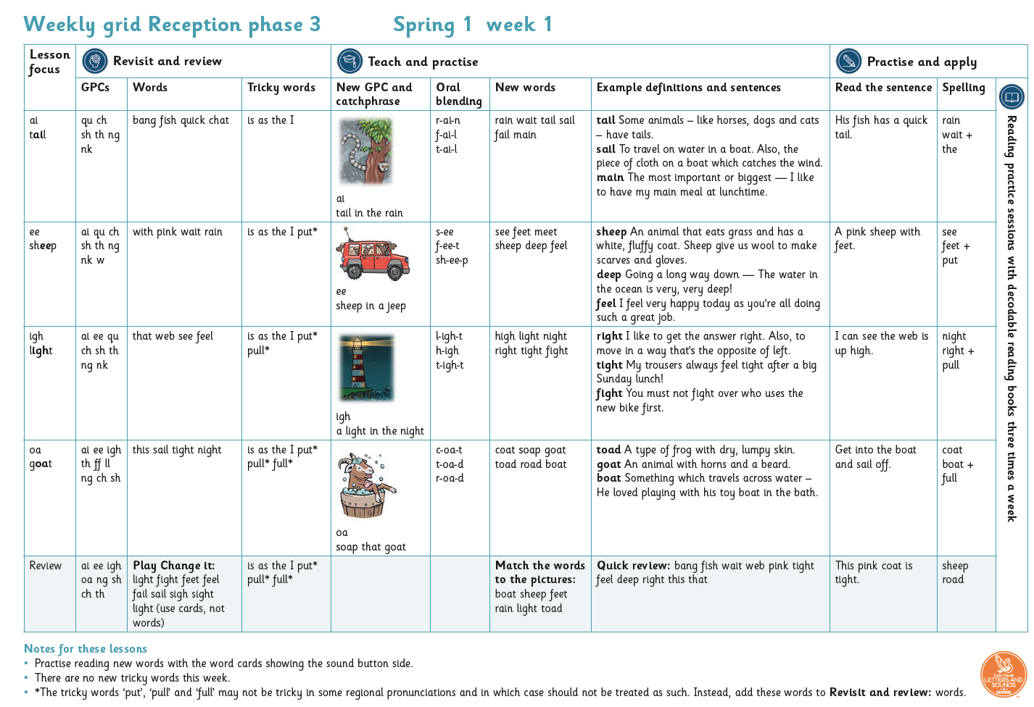
We have daily whole class phonics sessions following based on the Little Wandle scheme which is validated by the Department for Education. Below is an example of a weeks planning. We learn 4 sounds a week.
Phonics
Reception

Slide 5
The Little Wandle website has lots of useful information for you to support your child’s learning.
Click on the ‘For Parents’ tab.
Phonics
Reception

Slide 6
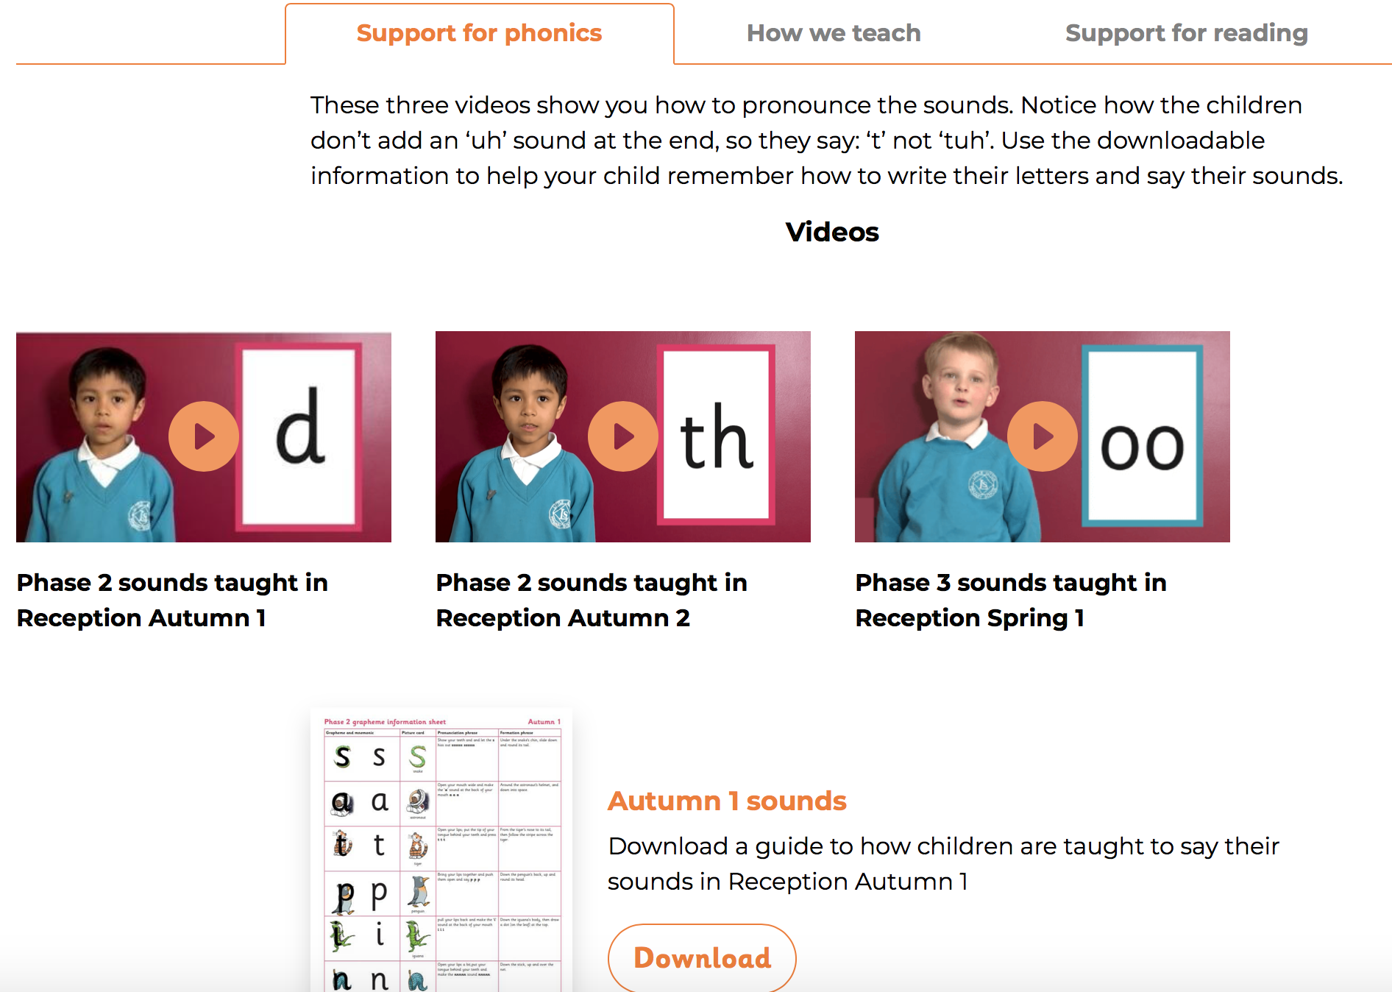
There are three tabs then for you to use.
Support for phonics with videos demonstrating how to say the sounds as well as a guide for each term.
Phonics
Reception

Slide 7
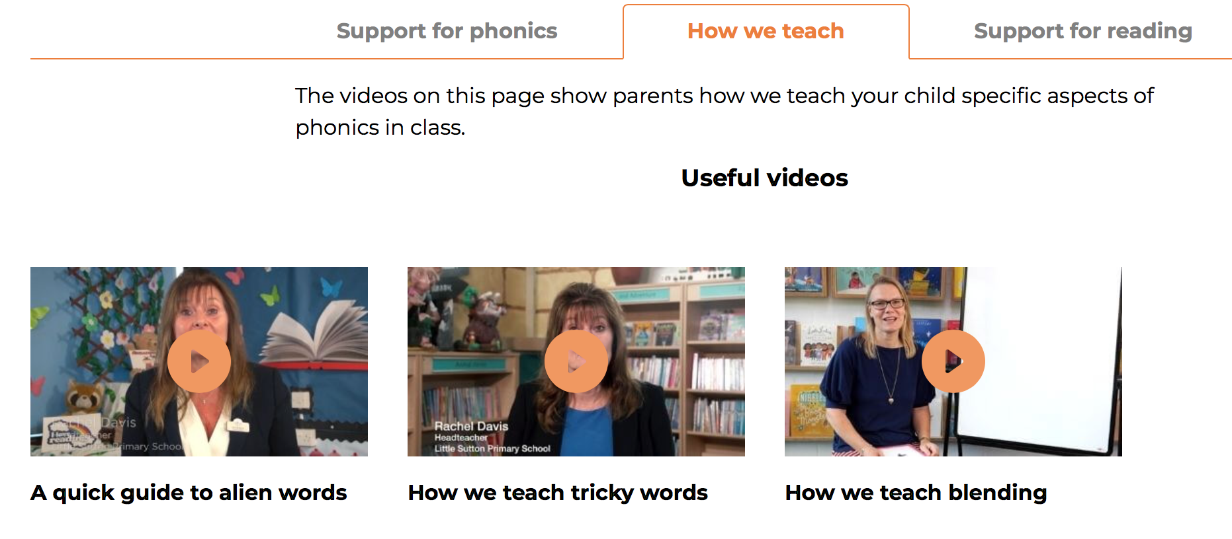
The ‘How we teach’ tab has videos demonstrating how the lessons we have at school.
Phonics
Reception

Slide 8
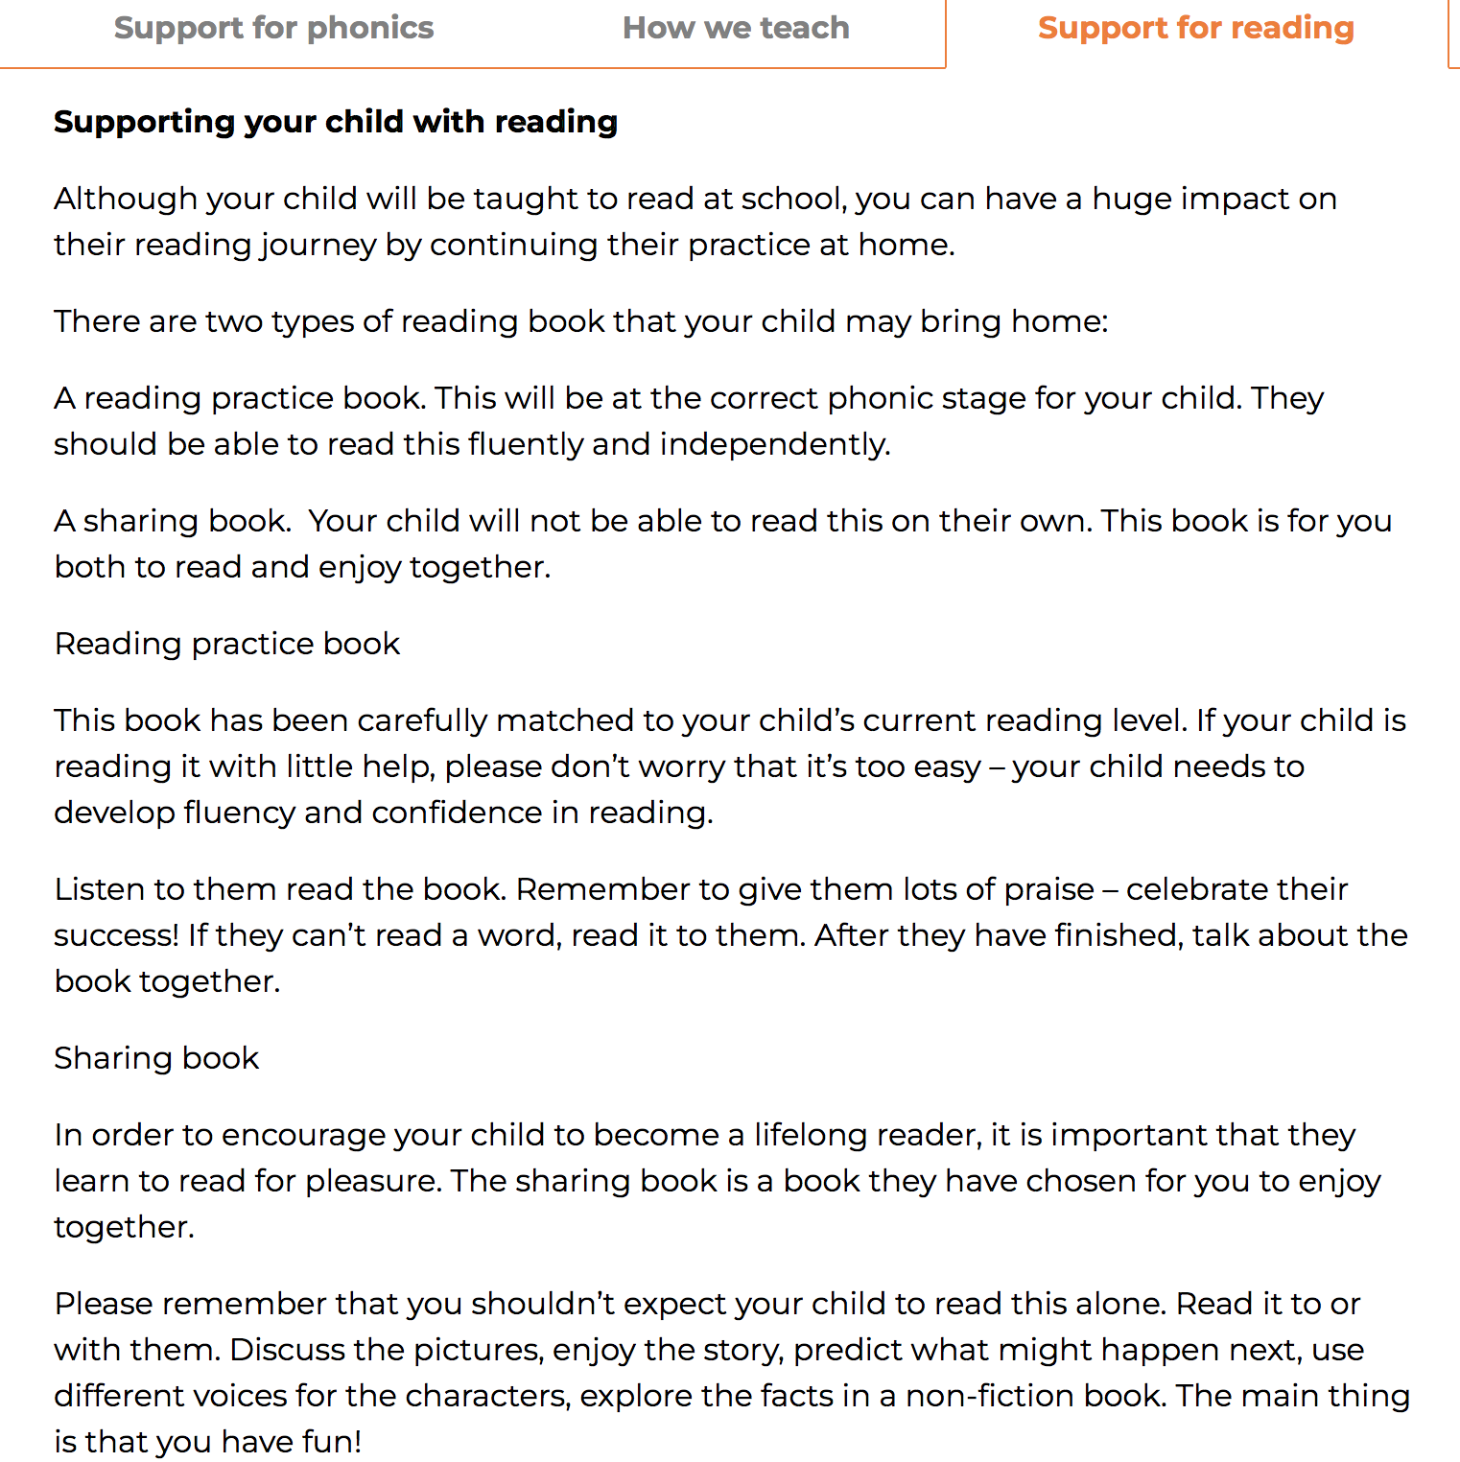
Finally the ’Support for reading’ tab has information about supporting your child in their reading journey.
Phonics
Reception

Slide 9
Reading in
Reception
We read three times a week with the children in class. The book allocated is linked to the phonics sounds the children know. The reading books are sent home from the reading sessions on a Monday and collected in on Friday for the next group. Please ensure that books are returned to school every day for the reading we do in class as we do not have any additional copies.
The sessions are as follows
De – coding
Prosody
Comprehension
These sessions are explained in the cover of each book.
Each day the children have the opportunity to bring home a library book for you to read together.
Please update your child’s reading diary every time you read the phonics book and the library book.

Slide 10
Reception
Thank you for your continued support and we are always here if we can help in any way.

