Slide 1
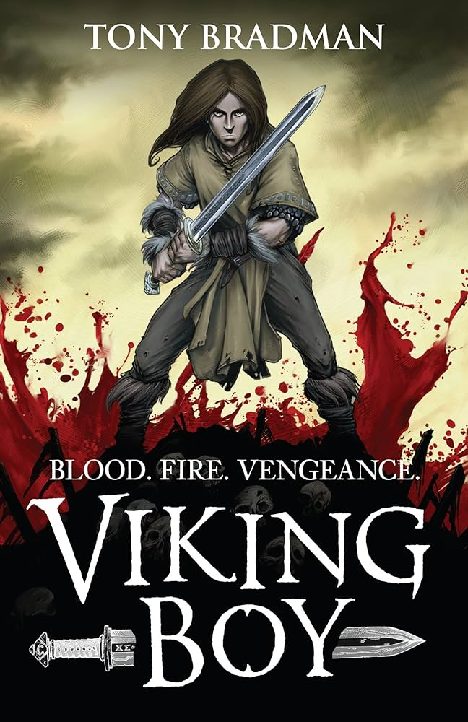
History
• Britain’s settlement by Anglo-Saxons and Scots
• The Viking and Anglo-Saxon struggle for the Kingdom of England to the time of Edward the
Confessor which includes Viking raids and invasion.
Geography
Narrative Writing
Explanation Text
Information:
Gunnar Bjornsson, a Viking, lives with his parents on their farmstead – an idyllic place to grow up. Gunnar had a happy childhood but everything changed the night the Wolf Men came. They murdered his father and Gunnar escaped after watching Valkyries descend from the sky and take the body of his father to the halls of Valhalla
Gunnar vowed to avenge this act by travelling to Valhalla to bring back his father so they could defeat the leader of the Wolf Men. On his journey, Gunnar was met by setbacks. Being kidnapped and sold into slavery was not part of his plan. However, with the help of some loyal friends he makes his was to the Land of Ice and Fire, across The Rainbow Bridge to Asgard and enters the Hall of Valhalla.
Key Characters
Gunnar | The son of a Viking chieftain, living peacefully.
Skuli and his wolf men | Raze Gunnar home and take his fathers life.
Key Vocabulary
Hearth | The floor of a fire place.
Tunic | A loose garment typically sleeveless that reaches the knee.
Scabbard | A container for a sword.
Runes | Letters of ancient alphabets.
Slaughter | To kill people or animals in a violent way.
Billowed | Fill with air and sweel outwards.
Oath | Promise often a calling from God.
Raiders | A person who attacks an enemy on their own land.
Cowering | Crouch down in fear.
Valkyries | Female warrior from Norse mythology sent to the battlefield to take fallen hero's.
Key Questions / Discussion Points:
— How does the poem sound to you?
— What does the language of the poem do? Do you like any particular words or phrases? Why?
— Does it have rhythm? How does it feel?
— Whose is the voice of the poem?
— What is the theme of the poem?
— What does the poem say to you as a reader?
— Would you like to write a poem like this?
— What type of poem is it?
— Can you recognise the form of the poem?
— How is it laid out?
Themes:
Bravery
Duty
Revenge

