Slide 1
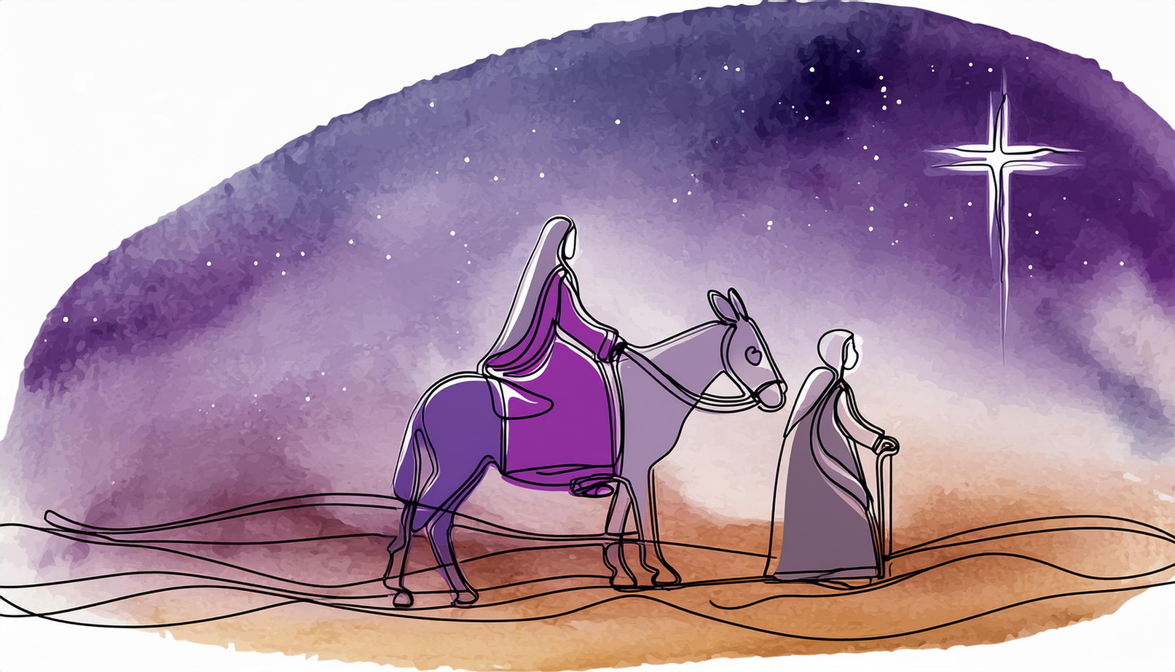
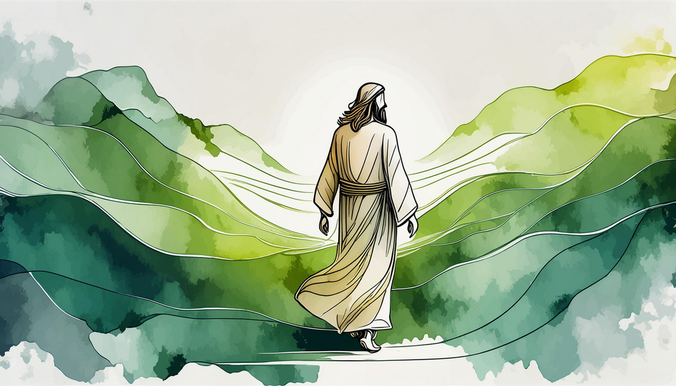
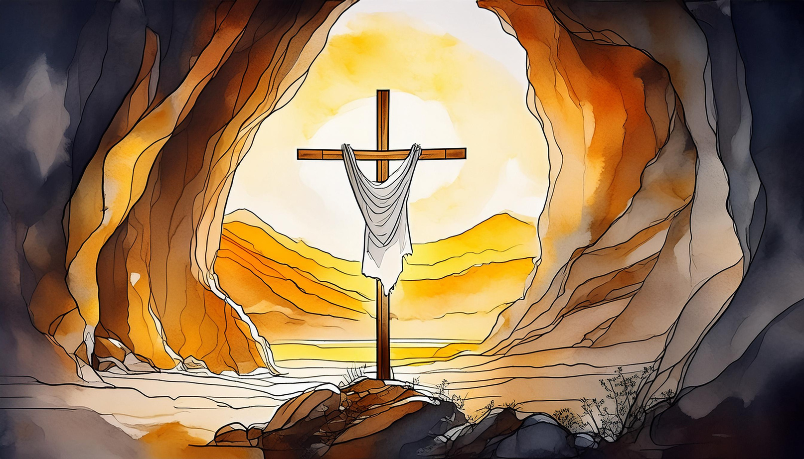

ANNUAL PLAN OF PROVISION
St Patrick’s Catholic Primary School
Our Lady of Lourdes
“Scripture Quote”

Slide 2

ANNUAL PLAN OF PROVISION
There is a time for everything, and a season for every activity under the heavens - Ecc 3:1
Policy Statement
This policy sets out a structure for Prayer and Liturgy over the Liturgical year. It has been produced in line with the Catholic Schools Inspectorate. The policy links to the Nottingham Diocese ‘Planning and Celebrating Prayer and Liturgy with Young People’ and should be read in conjunction with the ‘Prayer and Liturgy policy’ and the 'Prayer and Liturgy Progression document' for St Patrick’s school.
Policy Introduction
The policy sets out each aspect of planning Liturgy and prayer throughout the school for the whole of the liturgical year. All members of the community are continually involved in its evolving creation. The policy is divided into sections so that all areas of provision are carefully thought out.
Policy Rationale
This policy is a living document which is cyclical and will grow in time as to the needs of the school community in which it serves so that all may encounter and grow in faith.
Produced By: SLT
Updated on: May 2025
Next Review: Sept 2025

Slide 3
SEASONAL PROVISION
ATMOSPHERE & SEASONALITY
Seasonality is something that connects us all on a very human level. When considering our approach to planning and celebrating prayer and liturgy we need to think first of when in the life of the community it’s taking place. Just as the changing seasons outside help us get a feel for the time of year, so we must give special consideration to making the different seasons in the Church feel different too - Planning and Celebrating Prayer & Liturgy
 | Advent / Christmastide | Ordinary Time | Lent | Eastertide | Pentecost / Ordinary Time
Whole School | Reconciliation service Epiphany Celebration | Harvest festival | Ash Wednesday service Reconciliation service St Patrick’s Day | May – Month of Mary – Mary procession (crowning of Mary) | Pentecost Celebration Harvest Assembly October – Month of Mary – Focus on the Rosary St Therese of Liseux feast day
Class / Form | Daily prayer and lighting of the advent wreath |  |  |  | During October – daily rosary
Small groups | Prayer retreat- During advent | Remembrance prayer retreat | Lent Prayer retreat | Eastertide prayer retreat | Remembrance prayer retreat
Individuals | Sacred space prayer opportunity | Prayer stations – outside focus | Sacred space prayer opportunity | Prayer stations
Staff
Parents / Community | Class celebration of the word Nativity – F2/KS1 KS2 Carol Concert | Harvest festival | Class celebration of the word St Patrick’s Day Mass Easter story – KS1 Stations of the cross – KS2 | Class celebration of the word

Slide 4

ADVENT / CHRISTMASTIDE
Advent is a season of preparation and anticipation for the celebration of Jesus' birth. We aim to create a peaceful and reflective atmosphere throughout the school to encourage students to enter into the spirit of waiting and hope.
Classroom and School Environment
Classroom prayer tables – purple cloth, advent wreath
Discussion in classes daily about the significance of the advent wreath
Classroom RE displays – Purple border, purple border
Prayer stations around school to have purple cloths
Altar in the hall- purple cloth and advent wreath
Sacred space – purple lights, purple cloth and empty nativity scene
Travelling Nativity – classes to give all children the opportunity to take home the travelling nativity and share reflections from home to school.
Traditional Advent hymns and other advent music to be incorporated into class liturgies, lessons, masses and during prayer time.
Classes to have prepared the symbols for the Jesse tree to add to during Advent
Prayer and Liturgy
Daily lighting of the Advent wreath in classes
Focus on the Jesse tree and adding the symbols daily using tenten videos and resources
Focus on the Hail Mary prayer to show the importance of Mary’s role during advent
Whole school celebration of the word planned and delivered by pairs of classes and parents invited.
Mass during the final week of school
Overall Tone
Waiting in anticipation
Time of hope
Main a sense of quiet and reflection to allow pupils the opportunity to think about the true meaning of Christmas.
Events
Resource
Advent celebration of the word – parents invited every Monday during Advent. Pairs of classes plan and deliver a celebration of the word to the whole school including lighting of the Advent wreath
Class based celebration of the word weekly
F2 and KS1 Nativity
KS2 Carol concert
Hub schools singing programme carol concert
Advent retreat – planned by hub chaplains and children
Whole school mass
Nativity scene
Advent wreath including candles
Purple cloth
Jesse tree symbols
Travelling nativity
Advent hymns and music

Slide 5

ORDINARY TIME
Ordinary Time is the longest liturgical season, offering us a time for growth and deepening our faith. We celebrate the ongoing presence of Christ in our lives and strive to live out the Gospel message in our daily actions.
Classroom and School Environment
Green cloth on prayer tables and RE display
Green border on RE displays
Symbols of growth – World, leaves, flowers etc
Planting of flowers and use of outside areas for prayer time and celebration of the word
Prayer and Liturgy
  Prayer punctuated throughout the day, morning prayer, before and after dinner and end of the day
  Focus on the our father as we are called to be children of God
  Celebration of the word focused on Sunday readings and shaped around how we can follow the mission and be disciples
Overall Tone
Upbeat time of the liturgical year focused on growth and learning about Jesus and his life.
Events
Resources
Cafod’s Harvest festival
October – Month of Mary – Focus on the Rosary
All Saints day of obligation
St Therese of Lisieux feast day – house team celebration of the word
Black history month
Remembrance cdelebration of the word and prayer retreat
National Youth fun day
Feast of Christ the king
St Andrews day celebration
Anti-bullying
EYFS Chinese new year
Our Lady of Lourdes
St David’s day celebration
Green cloth
Symbols of growth
Harvest festival display of growth

Slide 6
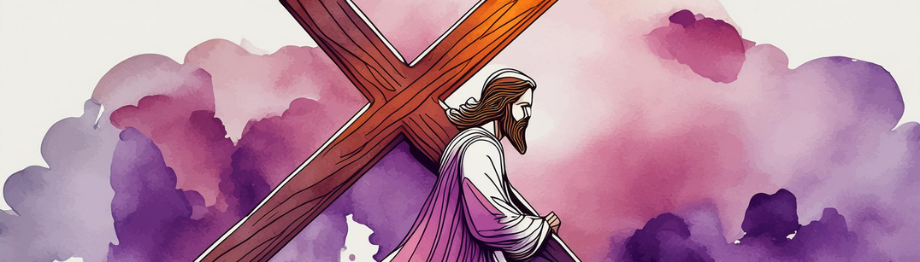
LENT
Lent is a season of reflection, repentance, and renewal. We journey with Jesus towards the cross, reflecting on our own need for forgiveness and striving to deepen our relationship with God.
Classroom and School Environment
Theme of purple around school including prayer table cloth, borders, whole school altar, prayer stations around the school.
Large cross displayed in the hall
Stations of the cross visible for all to see
Whole school Lenten journey display which includes children’s Lenten promises added
Footprints on doors
Pillars of Lent displayed on classroom doors
Scripture on classroom doors which is liturgically themed
Hymns and music to reflect the season and reflective nature of the season
Prayer and Liturgy
  Ash Wednesday service to begin Lent
  Daily prayer time in class which is reflective of the season and focused on the word of the week
  Lent reconciliation service
  Shared celebration of the word planned and delivered by children with invitations to parents and the community to join in the
Overall Tone
Encourage children to take part in the three pillars of lent, Prayer, fasting and almsgiving. Maintain a sense of calm and reverence throughout
.
Events
Resources
Ash Wednesday service
Weekly Celebration of the word – planned and led by classes and parents invited
St Patrick’s Day mass and celebration
CAFOD workshops and Big lent walk (Almsgiving)
Easter story – FS2 and KS1
Stations of the cross – KS2
Purple clothes
Stations of the cross
Whole school Lent display including lent promises
Footprints to show the journey through lent
Pillars of lent displayed around school
Big cross on the stage
Appropriate Lent hymns and music

Slide 7

EASTERTIDE
Eastertide is a season of great joy and celebration, marking the resurrection of Christ. We celebrate the new life that Jesus offers us and rejoice in the hope of eternal life.
Classroom and School Environment
Yellow, gold and white cloths on prayer tables and RE displays
Cross on stage draped with yellow and white
Whole school display including the cross and flowers to symbolize new life
Pupils' responses displays as to how they can be Easter people
Hymns and music to be reflective of the season
Prayer and Liturgy
Prayer punctuated throughout the day and to include the glory be as it praises the trinity and celebrates the resurrection
Celebration of the word scripture to focus on the resurrection
May to be dedicated to Mary including praying the Rosary (age appropriate)
Overall Tone
Happy and upbeat tone focusing on living out the message of the resurrection and sharing this with others.
Events
Resources
Easter retreat day across houses celebrating the resurrection
In class celebration of the word with invitations to parents
Month of May – dedication to Mary including Mary Procession and crowning of Mary and invitation of Mary’s meals into school.
Yellow, gold and celebratory coloured cloth for display
Flowers to symbolise new life
Sacred space to be Yellow until May and then Mary dedication to be created
Prayer garden to have a Mary focus with flowers

Slide 8

PENTECOST
Pentecost marks the descent of the Holy Spirit and the birth of the Church. We celebrate the gifts of the Holy Spirit and our call to share the Good News with the world. This then leads to our second period of Ordinary Time.
Classroom and School Environment
Red cloth to be used on the day of Pentecost, after Pentecost day, Green cloth and displays to be used with elements of red and orange to represent the flames of the holy spirit. This is on prayer tables, RE displays and around school
Pentecost themed whole school display – Flame and gifts of the holy spirit to be displayed – Pupil to create images to represent the holy spirit on Pentecost celebration day in school.
Prayer and Liturgy
Prayer to be punctuated throughout the day including a Pentecost prayer during morning prayers
Focus on how we can be inspired by the holy spirit and use the gifts we have been given
Celebration of the word scripture to focus on acts of apostles and growth of the early church and linked to our mission of being witnesses.
Overall Tone
Upbeat and positive tone.
Focus on living out the gifts of the holy spirit in our everyday lives
Events
Resources
Pentecost themed celebration in houses creating symbols of the holy spirit
Pentecost prayer retreat- linked to the gifts of the holy spirit
Class celebration of learning to show how we have lived out the gifts of the holy spirit
Red and orange colours
Gifts of the holy spirit display
Flames

Slide 9

PROVISION
RHYTHM OF PRAYER & LITURGY
When we look at more formal gatherings, such as Celebrations of the word and the variety of opportunities to experience prayer and liturgy in school, we must also look at the rhythm that each day / week / term takes and start to make decisions about how to further embed the seasons into the experiences of our community. The opportunity to use different start and end of day prayers for example, or to offer extra opportunities during different seasons, such as reconciliation during Advent and Lent, can all help shape an awareness for all people of the Church’s liturgical year. The important aspect to remember is to be deliberate and purposeful in shaping a rhythm of prayer and liturgy that is in harmony with the liturgical year, and that is engaging and accessible for all. - Planning and Celebrating Prayer & Liturgy
Following the Prayer and Liturgy policy, our weekly timetable has been designed to invite our children, their families, staff and all who are part of our school community, to join together in prayer and liturgy within a spirit of inclusion and accompaniment. The Word of the Week provides the prayeer focal point for the whole school community for that week.
The weekly timetable contains sessions for whole school, class, House groups and key stage gatherings which provides a breadth of opportunities for prayer and liturgy. Underpinning the variety of prayer opportunities are the school’s Prayer and Liturgy progression documents which ensure that the timetable of liturgy is progressive as to the developing abilities of the pupils. In addition, extended provision is in place with extra opportunities to shape an awareness for all people of the seasons of the Liturgical calendar.
Whole school celebration of the Word takes place at the very start of the week on a Monday morning and is led by a variety of staff, assisted by members of the Chaplaincy team. Prayer and liturgy is then punctuated throughout the week, with pupil planning of Celebration of the word on a Wednesday and delivering on a Thursday. Each week a different house group plans the class celebration of the word. On Wednesday we have a hymn practice which supports pupils in learning hymns which are appropriate for the season of the church year. During hymn practice, a timetable of pupil leadership enables groups to meet.
In class throughout the week, opportunities are built in to reflect on the word of the week and share examples of how the mission set during Monday’s celebration of the word has been lived out. This includes through 'Lectio Divina'.
Prayer time in class is punctuated throughout the day including at the beginning of the day, before and after lunch and at the end of the day with opportunities for spontaneous, meditation and other forms of alternative prayers built in throughout the day.
Whole class liturgies are planned at the end of an RE topic and each term parents are invited into school to take part in a class celebration of the word.
Throughout the year, each house team have an opportunity to lead their house feast day celebration of the word.
During Advent and Lent, classes plan celebration of the word which parents are invited to. In addition to this, reconciliation services take part during advent and lent.
 | Monday | Tuesday | Wednesday | Thursday | Friday
 | Celebration of the word- planned and led by adults | Mass – Whole school or buddy classes (on a rota- depending on priest availability) Hymn practice | Hymn Practice – developing understanding of hymns appropriate for the different times in the liturgical year | Class based celebration of the word | Whole school- Responding to the mission

Slide 10
LOCAL CONTEXT
Please refer to the 2024-25 school calendar with a weekly break down.
August
September
October
November
December
January
February
March
April
May
June
July

Slide 11
WEEKLY PLANNER
Word of the Week
Monday
Opportunities & Resources
Tuesday
Evaluation
By:
Wednesday
Thursday
Inclusion & Accessibility
Friday
Updates / News
Saturday / Sunday

Slide 12
EVALUATION AND MONITORING
Within the annual plan of provision is a rigorous monitoring and evaluation schedule so that the processes lead to progress throughout the school. This is set our as follows:
When monitored | What is being evaluated and monitored | Who is involved in evaluation and monitoring
Weekly | 1 whole school liturgy 1 class based liturgy 1 group based liturgy Mass ( every 3 weeks) | Chaplaincy team Selection of different pupils from class and house teams Congregation for Mass Parents/carers
Half termly | Half term liturgy evaluations | Prayer and Liturgy coordinators Link Governor visits
Termly | Subject action plans School Development Plan Leads into CSED update Pupil and staff feedback on prayer and liturgy | Subject leaders All staff Pupils Parents/carers Parish Link Governors LGB meeting
End of year | Effectiveness of school development plan and APOP leading to CSED updates with priorities identified for next academic year | All stakeholders contribute to the evaluation of prayer and liturgy. LGB meeting End of year Governor celebration and review

Slide 13
INCLUSIVE PRACTICE
Prayer and Liturgy is inclusive and accessible to all. All barriers must be removed by using a wide variety of strategies to support each individual to be fully included in all aspects of prayer and liturgy.
This will be achieved by:
Seasonality- Safe spaces, consideration of seating and positioning of support staff, ensuring that all pupils are together, the screen is visible to all- seek the voice of the children
Scripture- Scripture could be presented in a booklet as well as on screen alongside visual aids, Music. Screens should have clear sans serif fonts and high contrast background.
Senses- Being mindful of the sensory needs of children, giving careful consideration to the spaces when planning for liturgy in relation to physical needs and consider the use of support aids.
Structure- Consider ‘Now and Next’ approach in the planning and delivery of prayer and liturgy, adding graphics to power points. Using ‘now’ and ‘next’ throughout the structure of delivery consistently will enable children to better understand what is happening and why it is happening. Give space and time for thought within a balance of what we see, hear, think and do.
Using adaptive planning and evaluations.
Focus of inclusive practice and evaluation:
Advent – Senses
Lent – Seasonality and Scripture
Pentecost – Structure

Slide 14
OTHER FAITHS
Sensitivity is always taken to ensure that pupils of all faiths are included and respected.
When making the sign of the cross, pupils are ‘invited’ to make the sign of the cross.
Throughout the year, during dedicated weeks, pupils learn about other faiths including Judaism, Islam, Hinduism and Sikhism. A whole school focus on others world faiths ensures that throughout a pupil's time at St Patrick’s, they will learn about all aspects of other faiths including, important celebrations and festivals, places of worship, beliefs, holy books, customs and faith leaders.
Children are given an opportunity to handle artefacts and other faith leaders are invited into school to speak to pupils.
In our school we have pupils from a range of faith backgrounds. Links are made to identifying opportunities throughout the year to celebrate the richness of our community. For example, prayer stations may be dedicated to other faiths. Through the word of the week, we can weave other faiths instead of being stand alone sessions.
Examples of focus upon other faiths include:
-International Day of prayer
-Black History Month
-Cultural Diversity Days
-Christmas around the World
-Judaism- Hannukah
Ramadan
Show Racism the Red Card
 | Branch 1 – Creation and Covenant | Dialogue and Encounter other world faith Judaism | Dialogue and Encounter other world faith Sikhism | Branch 2 Prophecy and promise | Branch 3 Gailee to Jerusalem | Branch 4 Desert to Garden | Branch 5 To the ends of earth | Dialogue and Encounter other world faith Hinduism | Branch 6 – Dialogue and Encounter Other Christian faiths | Dialogue and Encounter other world faith Islam
Dates 2025/2026 | 3rd September to 10th October | 13th October to 17th October | 3rd November to 7th November | 10th November to 19th December | 5th January to 13th February | 23rd February to 27th March | 13th April to 22nd May | 1st June to 5th June | 8th June to 10th July | 13th July to 24th July

Slide 15
SKILL STRATEGY
A document such as this, which makes clear how young people grow and progress in prayer and liturgy, can help clarify the journey young people and staff will make as part of the community. Regularly reviewing the progression map can then help ensure that a spirit of growth and formation is continually fostered to ensure that prayer and liturgy remain engaging and accessible to all. -Planning and Celebrating Prayer & Liturgy with Young People
Please refer to the prayer and liturgy skill progression document

